Slide 1

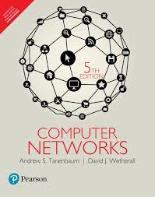
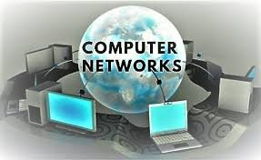
COMPUTER NETWORKS
Dr. U. SRILAKSHMI
Asst. Professor
Dept. of CSE
VFSTR

Slide 2
ARPANET
Advanced Research Projects Agency (ARPA) had a mission of advancing technology that might be useful to the military.
ARPA decided that the network should be packet- switched network, consisting of subnet and host computers.
The subnet would consists of minicomputers called IMPs( Interface Message Processors) connected by the transmission lines.
The subnet was to be datagram subnet, so if some lines and IMPs were destroyed, messages could be automatically rerouted along alternative paths.

Slide 3
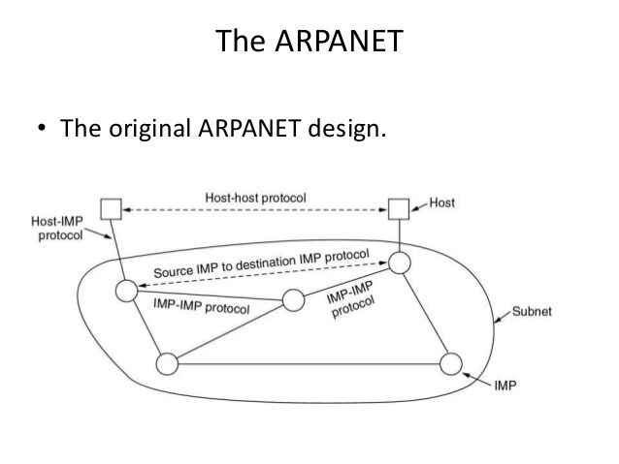
ARPANET
The software was split into two parts: subnet and host.
The subnet software consisted of the IMP end of the host-IMP connection, the IMP-IMP protocol, and a source IMP to destination IMP protocol designed to improve reliability.
Outside the subnet, software was also needed namely , the host end of the host-IMP connection, the host-host protocol, and the application software.
Later the IMP software was changed to allow terminals to connect directly to a special IMP, called a TIP (Terminal Interface Processor).

Slide 4
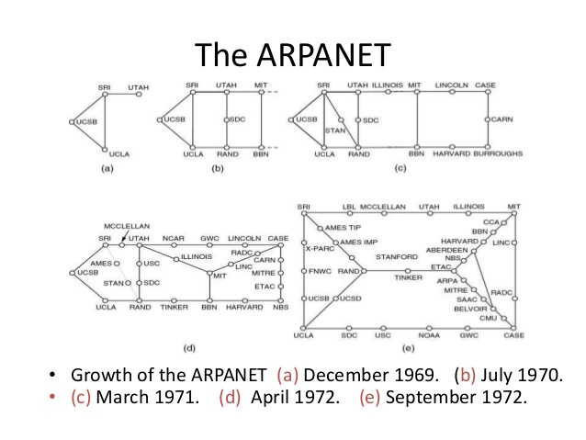

Slide 5
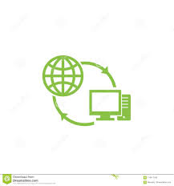
InterNet
Internet refers to collection of different physical networks like LAN, MAN,WAN in order to transmit data from one computer to another computer (or)
Internet is network of networks
E-mail
News
Remote login
File transfer

Slide 6
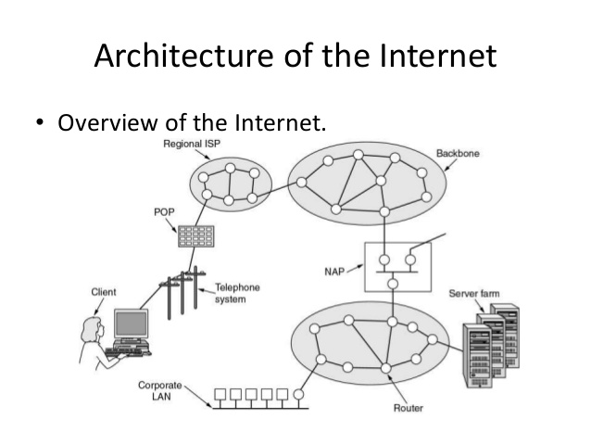
Architecture of the Internet

Slide 7
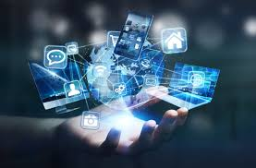
InterNet
The architecture of the mobile phone network is very different than that of the Internet.
First, there is the air interface. This term is a fancy name for the radio communication protocol that is used over the air between the mobile device (e.g., the cell phone) and the cellular base station.
Advances in the air interface over the past decades have greatly increased wireless data rates.
The UMTS air interface is based on Code Division Multiple Access (CDMA).

Slide 8
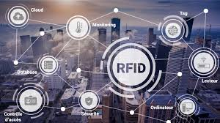
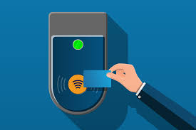
Radio Frequency Identification (RFID)
The networks we have studied so far are made up of computing devices that are easy to recognize, from computers to mobile phones.
With Radio Frequency IDentification (RFID), everyday objects can also be part of a computer network.
An RFID tag looks like a postage stamp-sized sticker that can be affixed to (or embedded in) an object so that it can be tracked.

Slide 9
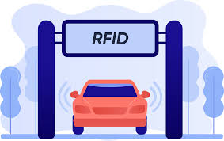
Radio Frequency Identification (RFID)
The object might be a cow, a passport, a book or a shipping pallet.
The tag consists of a small microchip with a unique identifier and an antenna that receives radio transmissions.
RFID readers installed at tracking points find tags when they come into range and interrogate them for their information.
Applications include checking identities, managing the supply chain, timing races, and replacing barcodes.

Slide 10
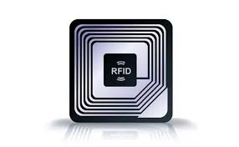
Radio Frequency Identification (RFID)
One common form of RFID is UHF RFID (Ultra-High Frequency RFID).
It is used on shipping pallets and some drivers licenses.
Another popular kind of RFID is HF RFID (High Frequency RFID).
It operates at 13.56 MHz and is likely to be in your passport, credit cards, books, and noncontact payment systems.
There are also other forms of RFID using other frequencies, such as LF RFID (Low Frequency RFID), which was developed before HF RFID.
It is used for animal tracking.

Slide 11
THANKS!
Any questions?

